Slide 1
Introduction to Machine Learning

Slide 2
What is Machine Learning?
“Computers that learn without being explicitly programmed”
“Using algorithms to understand patterns in data”
Data
Predictions & Insight
Algorithms

Slide 3
Machine Learning in Data Science Echosystem….
Domain Knowledge
Supply Chain
CRM
Financials
Networking
Domain Expertise
Engineering
Research
Unicorn
Scripting, SQL
Python, R Scala
Data Pipelines
Big Data/ Apache Spark
Computer
Science
Machine
Learning
Math & Stats
Mathematics
Computational
Data Science Projects Require multiple Skills

Slide 4

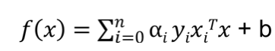
Machine Learning = Artificial Intelligence???
Data + Algorithms = Scored AI Models
Conversa- tion
Dialog
Language
Alchemy Language
Document Conversion
Discovery
Discovery News
Language Translator
Speech
Alchemy- Data News
Natural Language Classifier
Vision
Visual Recognition
Tradeoff Analytics
Natural Language
Under- standing
Text to Speech
Speech to
Text
Tone Analyzer
Retrieve and Rank
Personality Insights
Data Insights

Slide 5
Understanding AI, ML & DL Relationship…
AI
Artificial Intelligence
Machine Learning
Deep Learning

Slide 6

Methodology to create Machine Learning Model
Business understanding
Analytic approach
Feedback
Data requirements
Deployment
Data collection
Data Scientist/ Data Engineer
Statistician
Domain Expert
Evaluation
Data understanding
Modeling
Data preparation

Slide 7

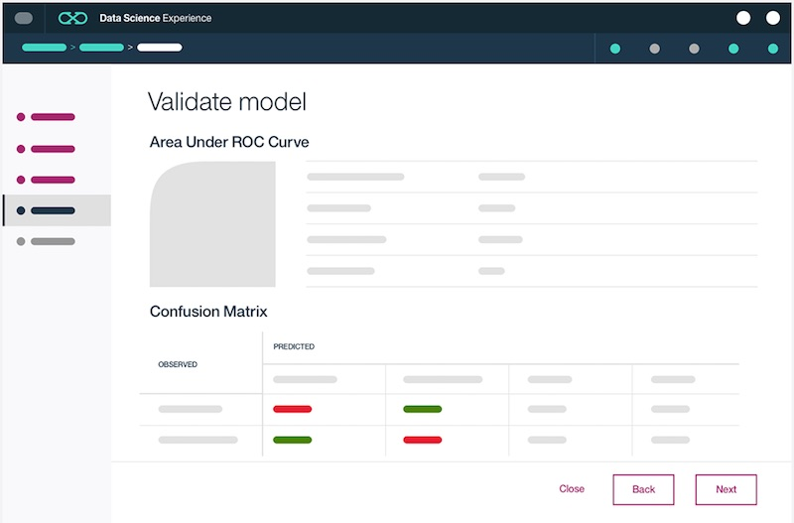


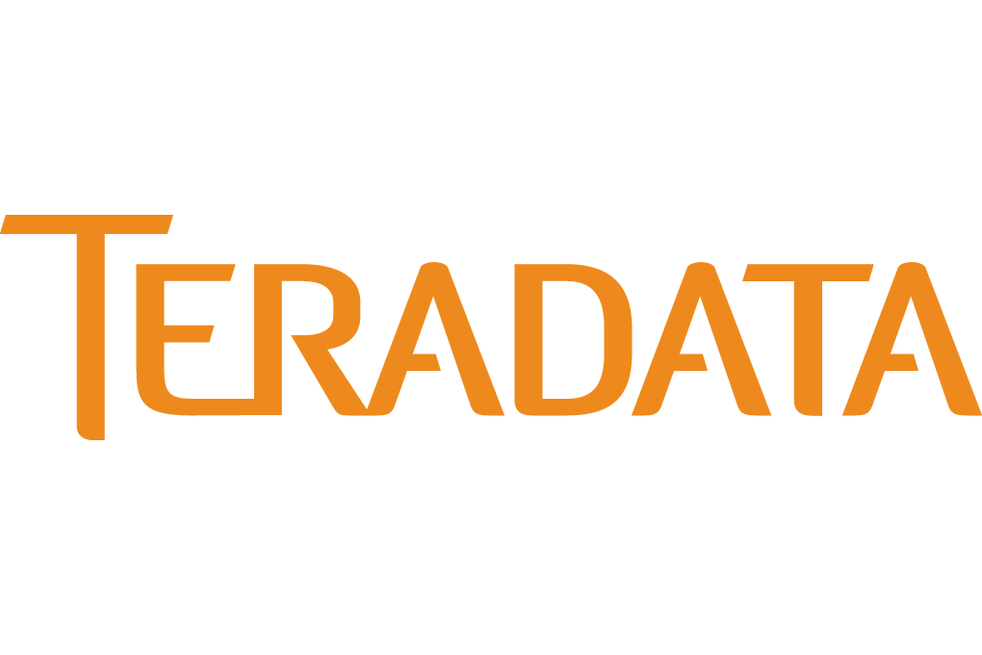


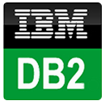

Introducing IBM Watson Machine Learning Accelerating Digital Deployments in Cloud…
Web Service
IMS
Data Access:
Easily connect to Behind-the-Firewall and Public Cloud Data
Catalogued and Governed Controls through Watson Data Platform
Creating Models:
Single UI and API for creating ML Models on various Runtimes
Auto-Modelling and Hyperparameter Optimization
Web Service:
Real-time, Streaming, and Batch Deployment
Continuous Monitoring and Feedback Loop
Intelligent Apps:
Integrate ML models with apps, websites, etc.
Continuously Improve and Adapt with Self-Learning
Notes:
Very few companies have systems in place today that can score, act, monitor, and ingest feedback. That’s where IBM Machine Learning (IBM ML) comes in. It was designed to support a continuous cycle of learning (i.e., “self-learning”). IBM ML solves a major pain point for customers by enabling them to build self-learning systems that can score, act, monitor, and ingest feedback to drive better business outcomes.
IBM Machine Learning enables you to create end-to-end pipelines with your data assets – it is the fabric that supports you in operationalizing insights from machine learning. A pipeline includes everything from connecting to your data sources, preparing your data, modelling, model evaluation, to model deployment and management.
Let’s start with the left-hand side of this chart. You can see that IBM ML can leverage the 30+ data connectors in Data Science Experience (DSX) to connect to your private cloud (on-premises) and public cloud data assets (e.g., Microsoft Azure, Amazon S3, Cloudant, etc.). These data assets can be catalogued and governed through additional Watson Data platform services. Within DSX there is both a Wizard UI and API for creating machine learning models on various runtimes (e.g. SparkML, SPSS, etc.). And to further assist Data Scientists during the modelling process, IBM ML has auto-modelling capabilities such as hyper parameter optimization.
Once the Data Scientist has built a model using IBM ML, the model can be deployed with a single click as a web service. IBM ML supports 3 forms of deployment – real-time, streaming, and batch deployment. To submit scoring requests against a deployed Watson Machine Learning model, simply ping the scoring endpoint with your authorization token. This enables IBM ML models to be integrated into websites, mobile applications, operational systems, dashboards, etc. to improve business outcomes across a variety of use cases (e.g. personalized recommendation as a mobile app, transaction risk scoring, call center content generation, etc.). The end application could be written in Java, JavaScript, Ruby, etc. or perhaps a mobile app on Android or iOS.
And once your models have been deployed, the DSX user interface (UI) provides continuous monitoring and feedback of your web service. Keep in mind that you aren’t limited to deploying your models into simple apps – you can also use the standard APIs included with IBM Machine Learning to integrate with complex operational systems. IBM ML can be the backbone of your customer’s “hard deploy” strategy for machine learning across their company (i.e., having machine learning dynamically baked into their systems).
Given the continuous monitoring and feedback loop capabilities of IBM ML, you may hear the term “self-learning” come up during customer conversations. When a customer mentions the need for a “self-learning” capability, they may be referring to:
The traditional way of building and retraining models (a Data Scientist follows all steps in building a model, including data evaluation, data preparation, model building, and model evaluation)
Auto-modeling, which is a technique where the Data Scientist does not “build a model” themselves through hand-tuning. Instead, the model is automatically built using an auto-modeling algorithm.
Automatic retraining of models. There are two main forms of “automatic retraining”:
If a model’s performance dips below a given threshold, then a model retraining process automatically kicks off
Using a streaming implementation of a machine learning algorithm (e.g. streaming K-means). These algorithm implementations automatically retrain as they receive new data points (e.g. exponential decay balancing importance of new vs. old data).

Slide 8

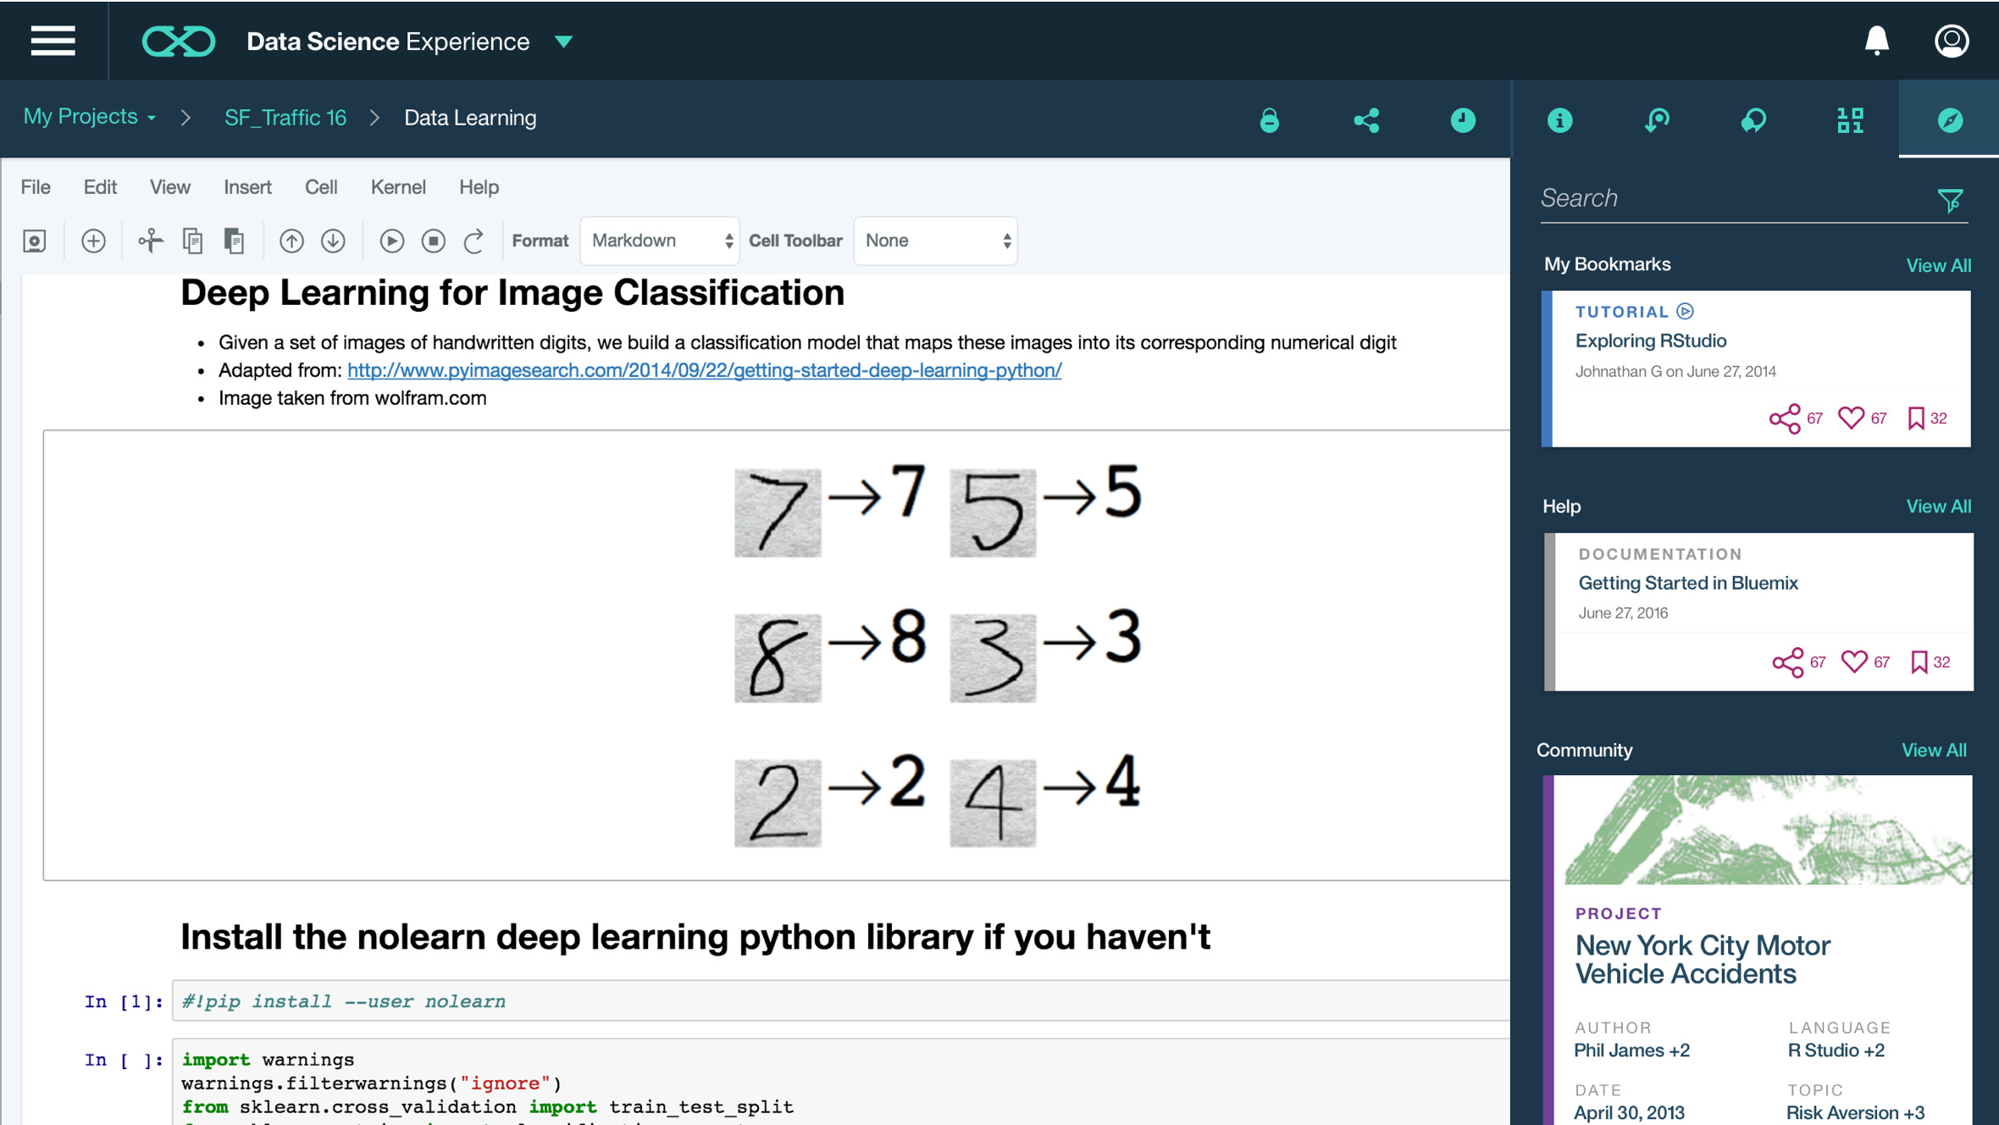
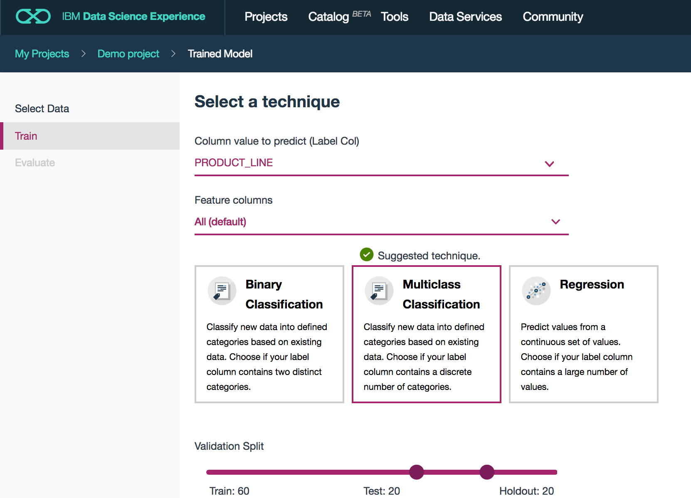
IBM Watson Machine Learning in Data Science Experience
Data Scientist
GA
APIs for Jupyter Notebooks
Model Builder GUI
Lab 2
Open Beta
Notes:
Now let’s take a look at IBM ML in Data Science Experience.
IBM Machine Learning is provisioned by default in Data Science Experience. It is our deployment fabric that enables Data Scientists to take their models from the lab to production. DSX provides a single UI for creating models, collaborating, deploying, monitoring, and integrating feedback. With a single click, Data Scientists can deploy their machine learning models as web services.
IBM ML is accessible in Data Science Experience via APIs (by coding in Notebooks), Wizard GUI (i.e., called “pipelines” in Projects), and the DSX Canvas (which is a GUI-based approach inspired by SPSS Modeler).
Note: At IBM ML GA in DSX (during 1H 2017) we expect to have both the APIs and Wizard GUI available. The DSX Canvas deployment via IBM ML will GA after the APIs and Wizard.
Also note that DSX Private Cloud will become the standard IDE for IBM ML for z/OS. This is expected to be delivered in 1H 2017.

Slide 9
WML GUI - Train multiple models at same time… System tells you best model…
Data Scientist
Open Beta

Slide 10
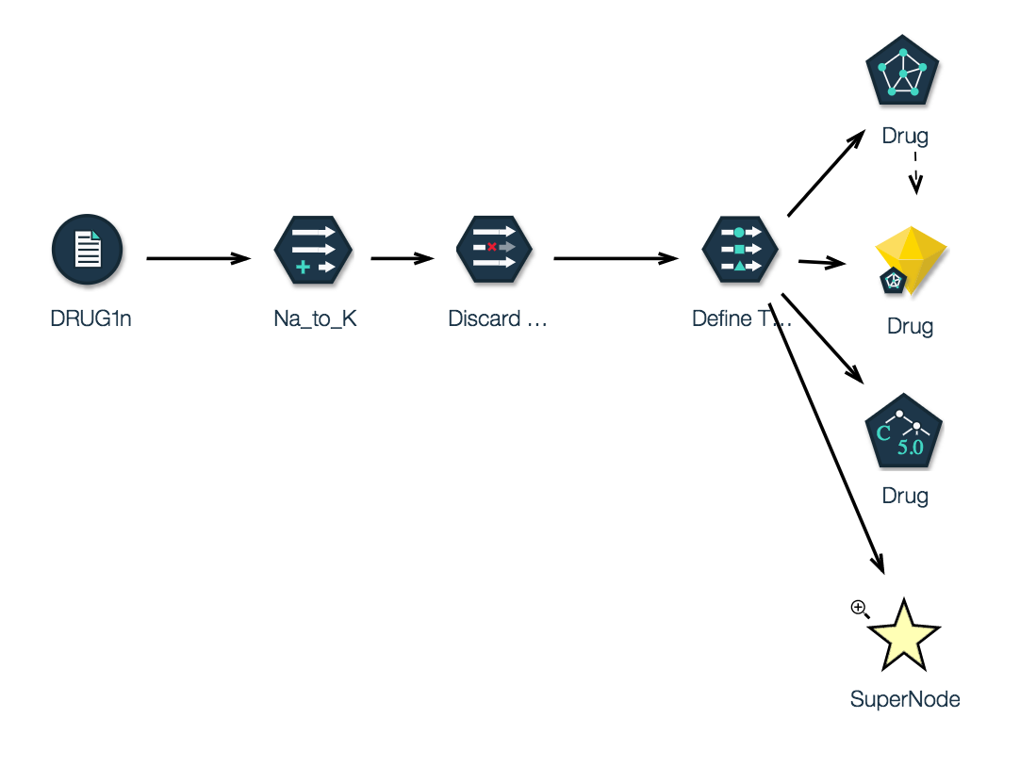
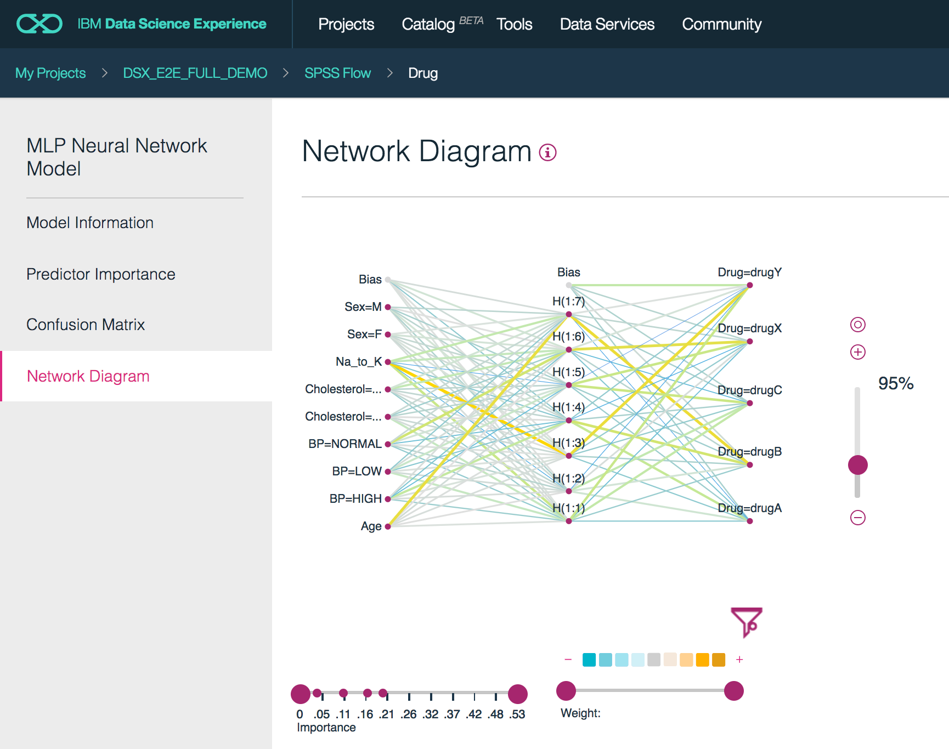
IBM Watson Machine Learning in Data Science Experience
Data Scientist
Open Beta
Flows
Create Advanced Models without coding
Advanced Model Visualization: Easy to understand their performance
Notes:
Now let’s take a look at IBM ML in Data Science Experience.
IBM Machine Learning is provisioned by default in Data Science Experience. It is our deployment fabric that enables Data Scientists to take their models from the lab to production. DSX provides a single UI for creating models, collaborating, deploying, monitoring, and integrating feedback. With a single click, Data Scientists can deploy their machine learning models as web services.
IBM ML is accessible in Data Science Experience via APIs (by coding in Notebooks), Wizard GUI (i.e., called “pipelines” in Projects), and the DSX Canvas (which is a GUI-based approach inspired by SPSS Modeler).
Note: At IBM ML GA in DSX (during 1H 2017) we expect to have both the APIs and Wizard GUI available. The DSX Canvas deployment via IBM ML will GA after the APIs and Wizard.
Also note that DSX Private Cloud will become the standard IDE for IBM ML for z/OS. This is expected to be delivered in 1H 2017.

Slide 11
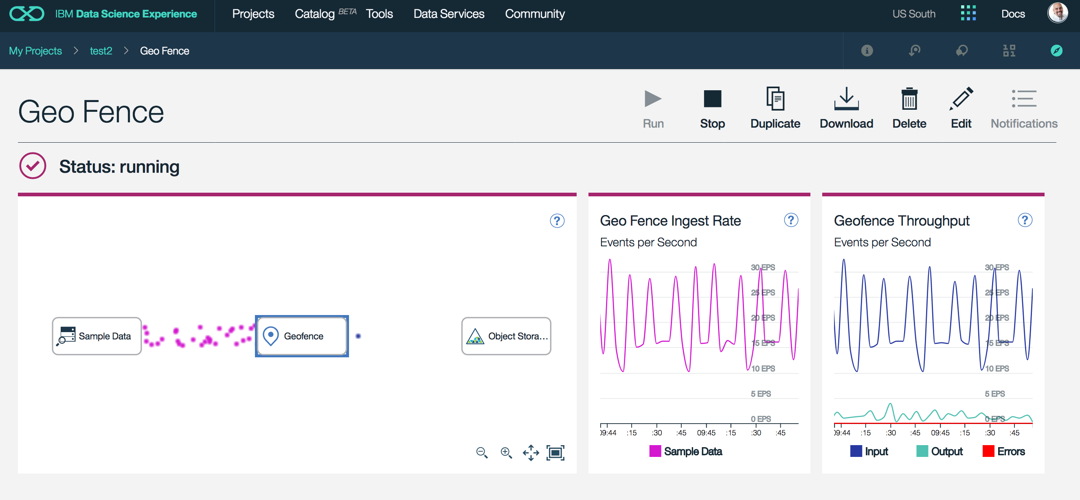
IBM Watson Machine Learning in Data Science Experience
Data Scientist
Open Beta
Streaming Pipelines
Notes:
Now let’s take a look at IBM ML in Data Science Experience.
IBM Machine Learning is provisioned by default in Data Science Experience. It is our deployment fabric that enables Data Scientists to take their models from the lab to production. DSX provides a single UI for creating models, collaborating, deploying, monitoring, and integrating feedback. With a single click, Data Scientists can deploy their machine learning models as web services.
IBM ML is accessible in Data Science Experience via APIs (by coding in Notebooks), Wizard GUI (i.e., called “pipelines” in Projects), and the DSX Canvas (which is a GUI-based approach inspired by SPSS Modeler).
Note: At IBM ML GA in DSX (during 1H 2017) we expect to have both the APIs and Wizard GUI available. The DSX Canvas deployment via IBM ML will GA after the APIs and Wizard.
Also note that DSX Private Cloud will become the standard IDE for IBM ML for z/OS. This is expected to be delivered in 1H 2017.

Slide 12
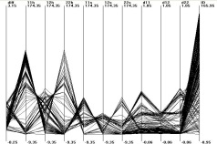






Data centric view of methodology
Data analysis
analytical
statistical
visual
Data ready
Data “pre”-processing
noisy/missing data
data corruption
dim. reduction
Models
Model/pattern evaluation
quantitative
qualitative
Data
Data sources
Data Collection
databases
data warehouses
Hadoop
“Good” model
Model/patterns deployment
prediction
decision support
New data

Slide 13
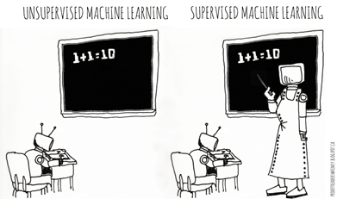
Categories of Machine Learning
Supervised learning
The program is “trained” on a pre-defined set of “training examples”, which then facilitate its ability to reach an accurate conclusion when given new data
The algorithm is presented with example inputs and their desired outputs (correct results)
The goal is to learn a general rule that maps inputs to outputs
Unsupervised learning
No labels are given to the learning algorithm, leaving it on its own to find structure (patterns and relationships) in its input
Unsupervised learning can be a goal in itself (discovering hidden patterns in data) or a means towards an end (feature learning)

Slide 14
Categories of Machine Learning
 | Discrete Output | Continuous Output
Supervised Learning (require Ground-Truth) | Classification (outcome is discrete) Binary Classification Linear Models (Logistic Regression) Decision Trees Naïve Bayes Multi class Classification Decision Trees Naïve Bayes K-NN | Regression - Linear Ridge Lasso Decision Trees Random Forest Gradient Boosted Trees
Unsupervised Learning (no Ground-Truth data required) | Clustering - k-means FP-Growth | Clustering - k-means - Gaussian Mixture Dimensionality Reduction - PCA - SVD

Slide 15
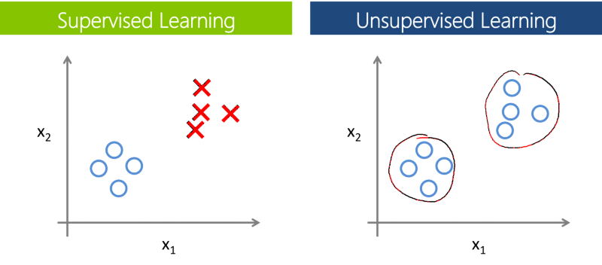
Supervised vs. Unsupervised Learning

Slide 16
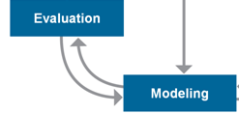
Training, testing, & validation sets
During the model development process, supervised learning techniques employ training and testing sets and sometimes a validation set.
Historical data with known outcome (target, class, response, or dependent variable)
Source data randomly split or sampled… mutually exclusive records
Why?
Training set ➔ build the model (iterative)
Testing set ➔ tune the parameters & variables during model building (iterative)
Assess model quality during training process
Avoid overfitting the model to the training set
Validation set ➔ estimate accuracy or error rate of model (once)
Assess model’s expected performance when applied to new data

Slide 17

Machine Learning – A more formal definition
Tom Mitchell of Carnegie Mellon University provides a widely quoted, more formal definition of machine learning
"A computer program is said to learn from experience E with respect to some class of tasks T and performance measure P if its performance at tasks in T, as measured by P, improves with experience E"

Slide 18
Q & A
?

